Slide 1


Flower Prediction Model
Team Members:
1. Varun Gupta, 500101910, Semester 5, AIML (Hons.)
2. Lavanya Arora, 500101681, Semester 5, AIML (Hons.)

Slide 2


Content
Abstract
Introduction
Problem Statement
Motivation
Objective
Methodology
Applications
Conclusion

Slide 3
Abstract
Project Overview: Develops a machine learning-based system to predict flower species using measurable features such as petal and sepal dimensions.
Key Features: Automates the classification process, reducing human effort and eliminating potential errors.
Data Utilization: Leverages structured datasets (e.g., Iris dataset) for training and testing the model.
Technology Stack: Implements advanced machine learning algorithms such as Decision Trees, Support Vector Machines, or Neural Networks for accurate predictions.
Scalability: Provides a scalable solution suitable for both small and large datasets.
Efficiency: Reduces the time needed for species identification compared to traditional methods.

Slide 4
Introduction
Purpose: The project aims to simplify the process of identifying flower species by automating it using machine learning techniques.
Inspiration: Traditional methods require manual examination by experts, which can be time-consuming and error-prone.
Core Concept: Machine learning algorithms analyze measurable features (e.g., petal length and sepal width) to identify species with high accuracy.
Scope: Focuses on leveraging structured datasets for training models and ensuring reproducibility of results.

Slide 5
Motivation
Scientific Motivation: Assist researchers in identifying species for biodiversity studies and botanical research.
Practical Use: Help farmers, gardeners, and hobbyists identify flowers accurately and efficiently.
Environmental Importance: Aid in monitoring and preserving plant ecosystems by providing tools to track species diversity.
Innovation in Technology: Demonstrates the power of ML to simplify and enhance tasks in botany and agriculture.

Slide 6
Problem Statement
Identifying flower species manually requires expertise and time, making it impractical for large datasets.
Misidentification or errors can occur, especially in non-specialist or high-pressure scenarios.
A machine learning-based system provides an automated, consistent, and scalable solution to this problem.

Slide 7
Objective
Design a machine learning model to classify flower species using features such as petal and sepal dimensions.
Achieve high predictive accuracy through data preprocessing, feature selection, and model optimization.
Provide an automated tool that is easy to use and applicable in various domains like research, gardening, and farming.

Slide 8
Methodology
Data Collection:
Use datasets like the Iris dataset or custom flower datasets with labelled features.
Features include petal length, petal width, sepal length, and sepal width.
2. Data Preprocessing:
Handle missing or inconsistent data, normalize values, and ensure data quality.
Perform exploratory data analysis (EDA) to identify key patterns and correlations.
3. Model Selection:
Experiment with algorithms like Logistic Regression, Decision Trees, K-Nearest Neighbors (KNN), Support Vector Machines (SVM), and Neural Networks.
Choose the best-performing model based on initial tests.
4. Training and testing:
Split data into training and testing sets (e.g., 80%-20%).
Train the model, fine-tune hyperparameters, and validate performance on unseen data.

Slide 9
Methodology
5. Evaluation:
Use metrics like accuracy, precision, recall, F1 score, and confusion matrix for performance evaluation.
Compare results with baseline models for validation.
6. Deployment:
Package the model into a user-friendly application or web interface for practical use.

Slide 10
Model 1
3. Key Insights:
Significant improvement in accuracy and reduction in loss across epochs.
Validation accuracy consistently outperformed training accuracy, indicating effective generalization.
4. Future Steps:
Fine-tune the base model for further improvement.
Experiment with hyperparameter tuning and learning rate scheduling.
1. Model Overview:
Base Model: EfficientNetB0 (pre-trained, non-trainable).
Input Shape: (224, 224, 3).
Custom Layers:
Data augmentation for generalization.
Global Average Pooling for dimensionality reduction.
Dense layer with softmax activation for multi-class classification.
2. Training Details:
Loss Function: Categorical Crossentropy.
Optimizer: Adam.
Epochs: 5.

Slide 11
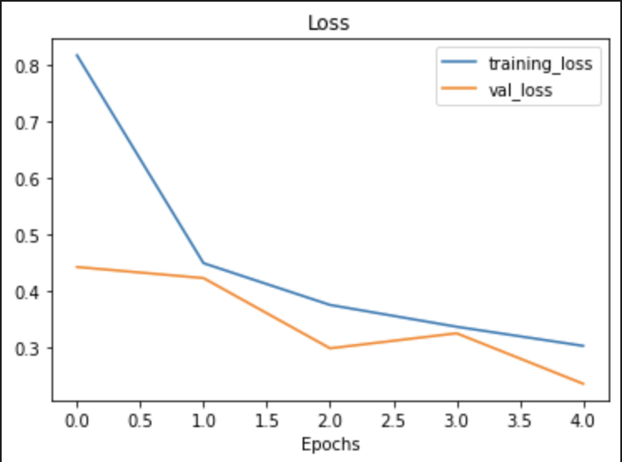
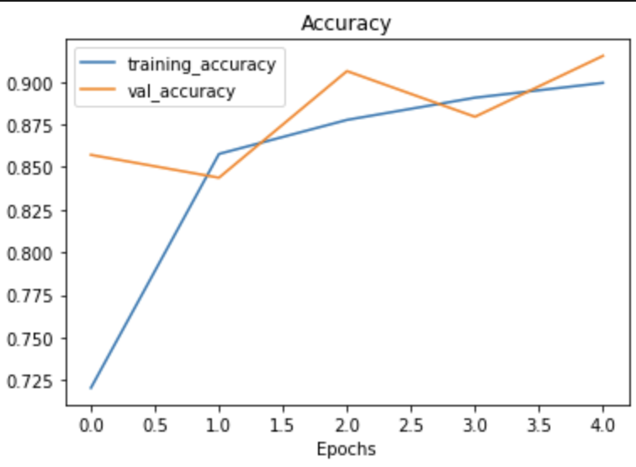
Performance Summary:
Metric | Training | Validation
Initial Accuracy | 72.06% | 85.71%
Final Accuracy | 89.93% | 91.52%
Initial Loss | 0.8168 | 0.4429
Final Loss | 0.3036 | 0.2366

Slide 12
Model 2
3. Key Insights:
Achieved steady improvement in accuracy and loss over epochs.
Validation metrics are closely aligned with training metrics, demonstrating effective generalization.
ResNet50V2 proved to be a robust feature extractor.
4. Future Steps:
Fine-tune ResNet50V2 layers for enhanced performance.
Explore advanced augmentation techniques and additional epochs for further optimization.
1. Model Overview:
Base Model: ResNet50V2 (pre-trained, non-trainable).
Input Shape: (224, 224, 3).
Custom Layers:
Rescaling for normalization.
Data augmentation for improved generalization.
Global Average Pooling for feature extraction.
Dense output layer with 5 units and softmax activation for classification.
2.Training Details:
Loss Function: Categorical Crossentropy.
Optimizer: Adam.
Epochs: 5.

Slide 13
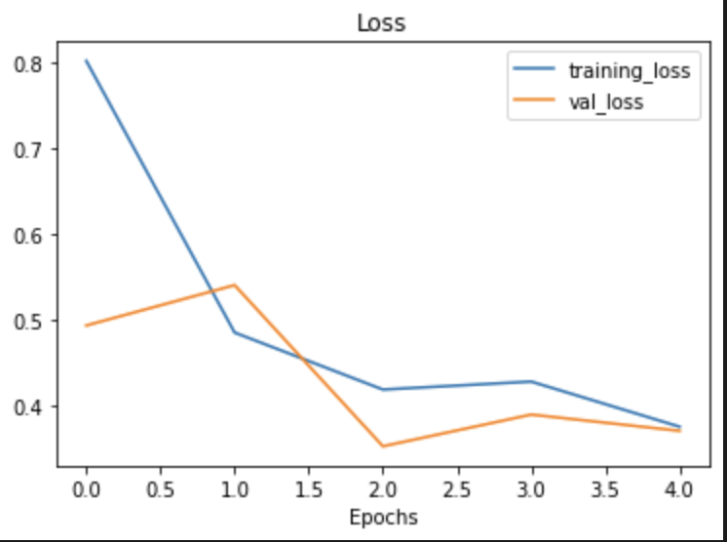
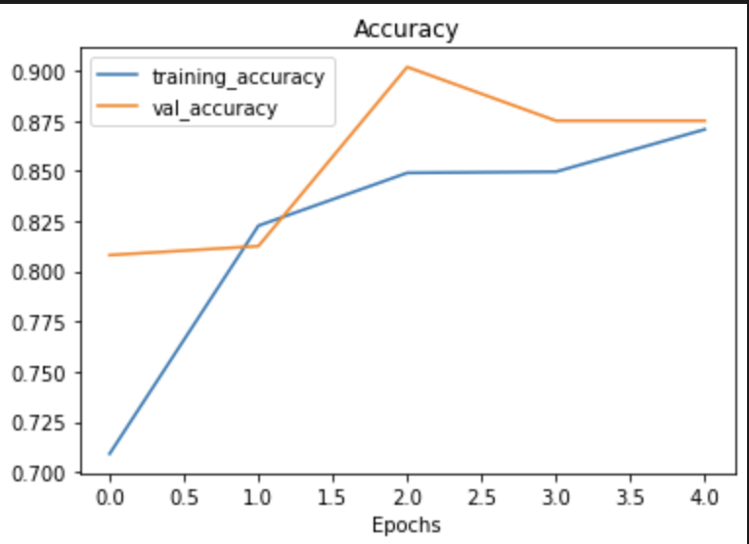
Performance Summary:
Metric | Training | Validation
Initial Accuracy | 70.90% | 80.80%
Final Accuracy | 87.07% | 87.50%
Initial Loss | 0.8014 | 0.4933
Final Loss | 0.3755 | 0.3707

Slide 14
Application
Botanical Research: Automate the identification of flower species for research projects and publications.
Gardening: Assist gardeners and landscape designers in identifying and cataloguing flowers.
Environmental Monitoring: Enable tracking of plant species to study biodiversity and environmental health.
Agriculture: Help classify crops, identify invasive species or weeds, and optimize farming practices.
Education: Provide students and educators with a learning tool for plant taxonomy and machine learning.

Slide 15
Conclusion
The Flower Prediction ML project demonstrates the potential of machine learning in automating and simplifying species identification. It reduces the reliance on manual methods, enhances efficiency, and opens up new opportunities in botany, agriculture, and environmental science. Future work includes expanding the dataset to cover a broader range of flower species and integrating image-based features for real-time prediction. This project highlights the growing intersection between technology and environmental sciences.

Slide 16
Thank You

